Slide 1
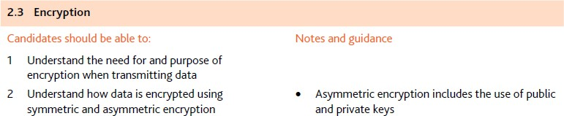
Learning Objectives

Slide 2
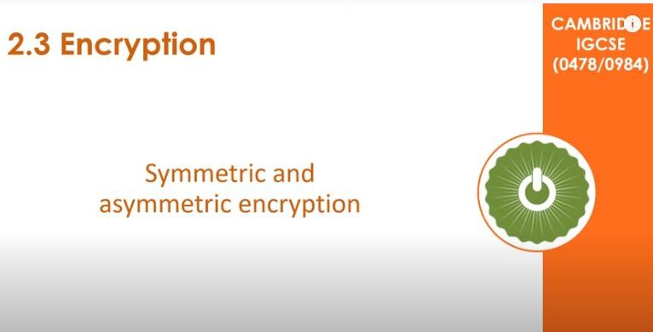
2.3 Encryption
https://www.youtube.com/watch?v=Ih7BT2uFKh4

Slide 3

2.3 Encryption
Understanding Encryption!
https://www.youtube.com/watch?v=1y1M2fZqIlQ

Slide 4
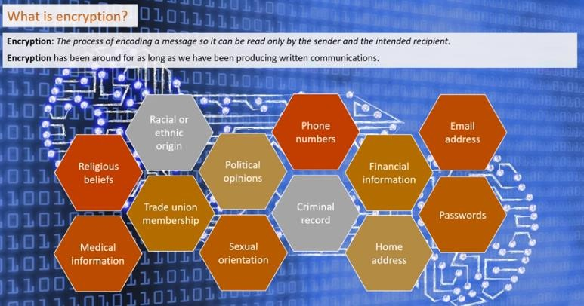
2.3 Encryption

Slide 5
2.3 Encryption
What is encryption?
Encryption is a process that scrambles readable text so it can only be read by the person who has the secret code, or decryption key. It helps provide data security for sensitive information.
Vast amounts of personal information are managed online and stored in the cloud or on servers with an ongoing connection to the web. It’s nearly impossible to do business of any kind without your personal data ending up in an
organization’s networked computer system, which is why it’s important to know how to help keep that data private.
How does encryption work?
Encryption takes plain text, like a text message or email, and scrambles it into an unreadable format — called “cipher text.” This helps protect the confidentiality of digital data either stored on computer systems or transmitted through a network like the Internet.
When the intended recipient accesses the message, the information is translated back to its original form. This is called decryption.
To unlock the message, both the sender and the recipient have to use a “secret” encryption key — a collection of
algorithms that scramble and unscramble data back to a readable format

Slide 6
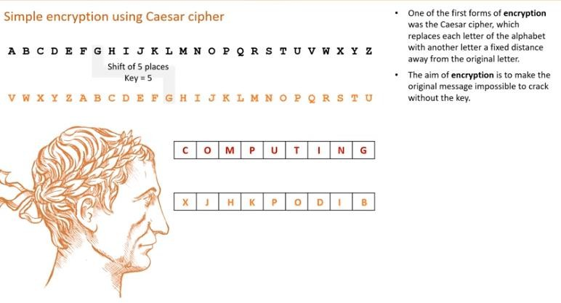
2.3 Encryption

Slide 7
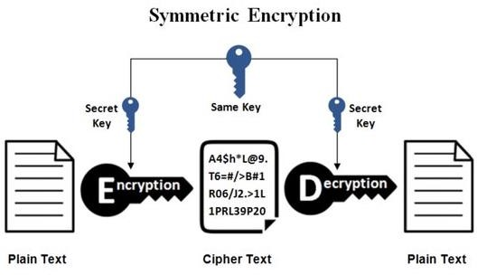
2.3 Encryption
Symmetric Encryption
Symmetric encryption uses a single key to encrypt and decrypt. If you encrypt a zip file, then decrypt with the same key, you are using symmetric encryption. Symmetric encryption is also called “secret key” encryption because the key must be kept secret from third parties.
Again Symmetric cryptography, known also as secret key cryptography, is the use of a single shared secret to share encrypted data between parties. Ciphers in this category are called symmetric because you use the same key to encrypt and to decrypt the data.

Slide 8
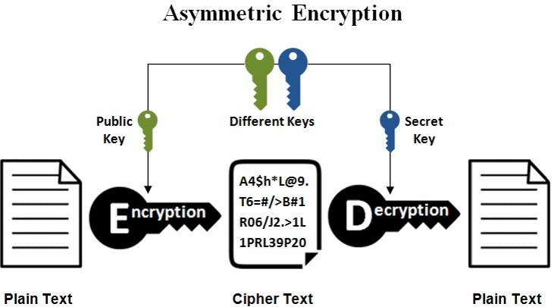
2.3 Encryption
Asymmetric Encryption
Asymmetric cryptography, also known as public-key cryptography, is a process that uses a pair of related keys one public key and one private key to encrypt and decrypt a message and protect it from unauthorized access or use.
A public key is a cryptographic key that can be used by any person to encrypt a message so that it can only be decrypted by the intended recipient with their private key. A private key -- also known as a secret key -- is shared only with key's initiator.
When someone wants to send an encrypted message, they can pull the intended recipient's public key from a
public directory and use it to encrypt the message before sending it. The recipient of the message can then decrypt the message using their related private key.
If the sender encrypts the message using their private key, the message can be decrypted only using that sender's public key, thus authenticating the sender. These encryption and decryption processes happen automatically; users do not need to physically lock and unlock the message.

Slide 9
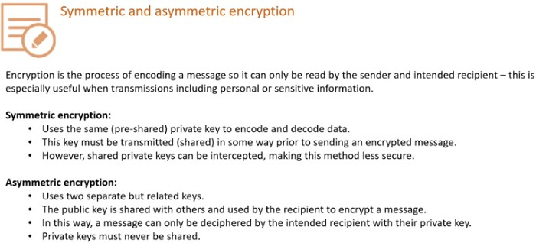
2.3 Encryption

Slide 10
Write Down questions in your notes and answer them afterwards check correct answers

Slide 11
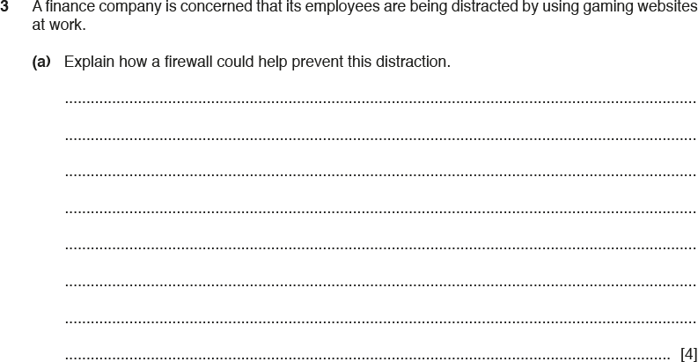
IGCSE Past Paper Exam – Question 1
By: Noureddine Tadjerout

Slide 12
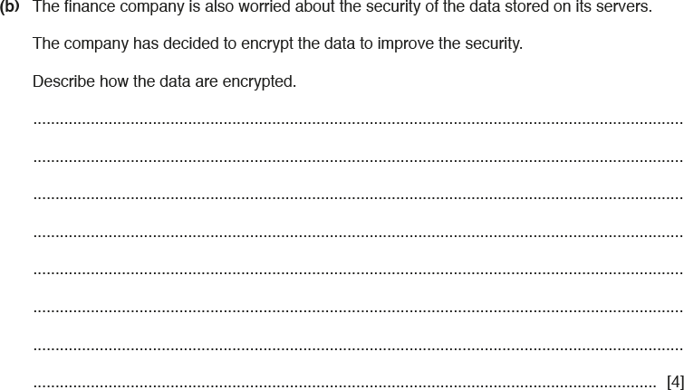
IGCSE Past Paper Exam – Question 1
By: Noureddine Tadjerout

Slide 13
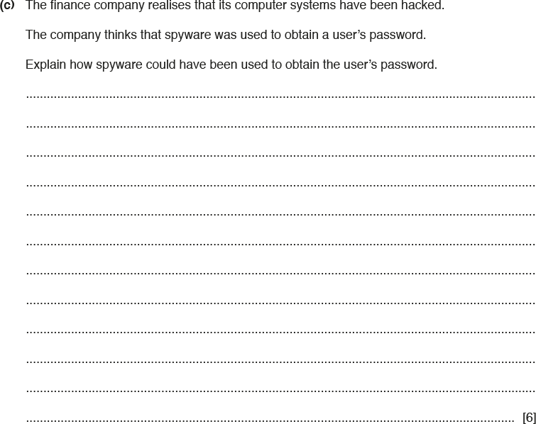
IGCSE Past Paper Exam – Question 1
By: Noureddine Tadjerout

Slide 14
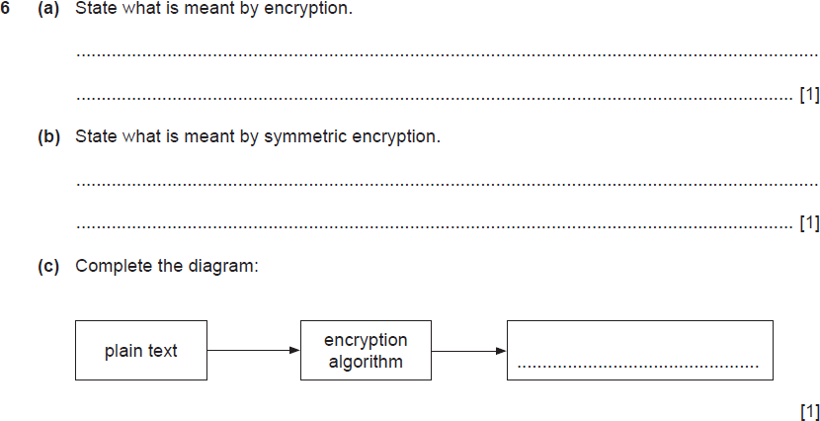
IGCSE Past Paper Exam – Question 2
By: Noureddine Tadjerout

Slide 15
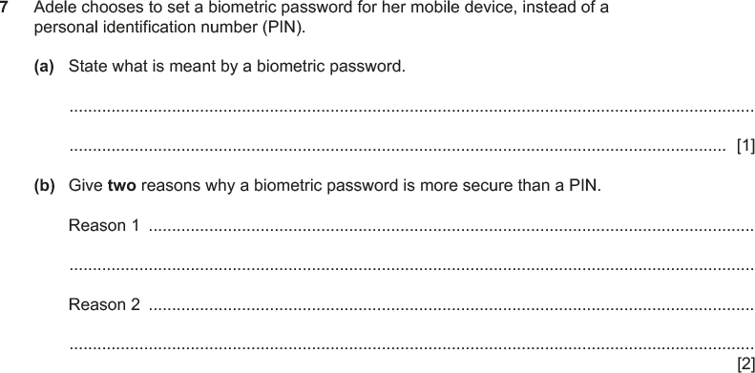
IGCSE Past Paper Exam – Question 3
By: Noureddine Tadjerout

Slide 16
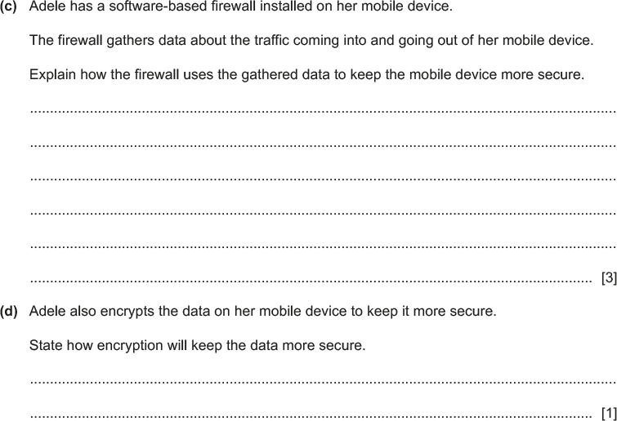
IGCSE Past Paper Exam – Question 3
By: Noureddine Tadjerout

Slide 17
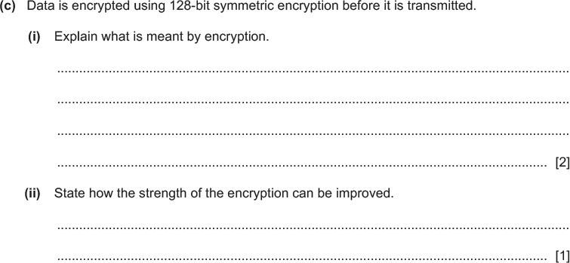
IGCSE Past Paper Exam – Question 4
By: Noureddine Tadjerout

Slide 18
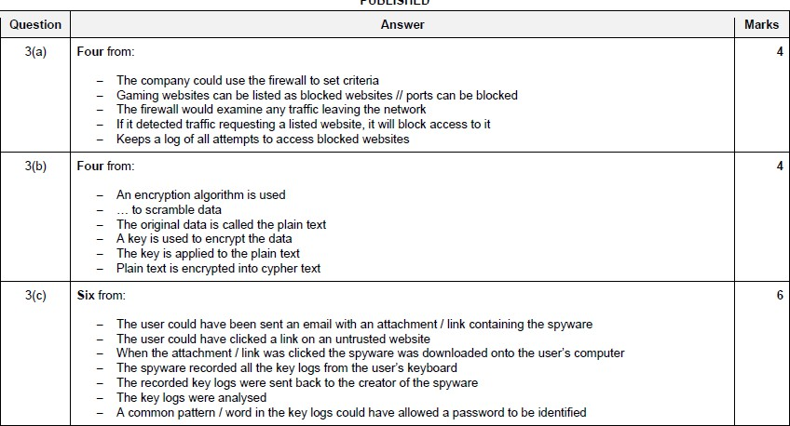
IGCSE Past Paper Exam – Answer 1
By: Noureddine Tadjerout

Slide 19
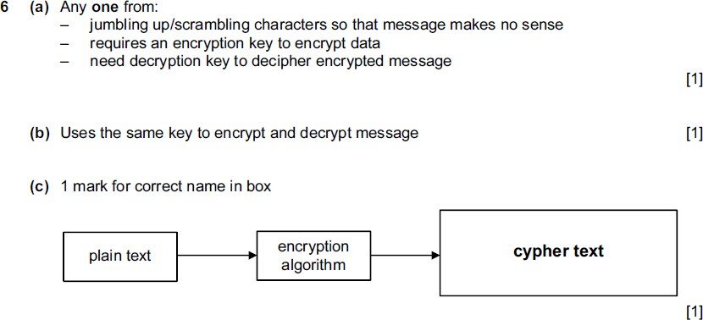
IGCSE Past Paper Exam – Answer 2
By: Noureddine Tadjerout

Slide 20
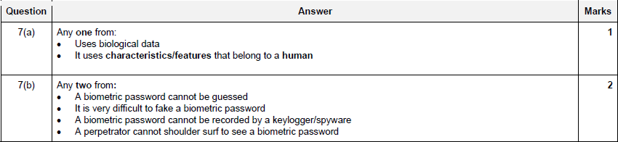
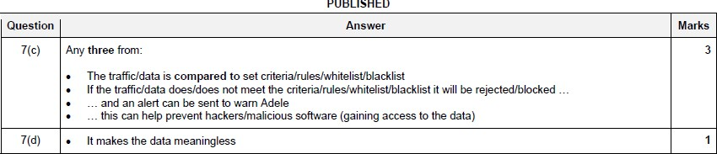
IGCSE Past Paper Exam – Answer 3
By: Noureddine Tadjerout

Slide 21
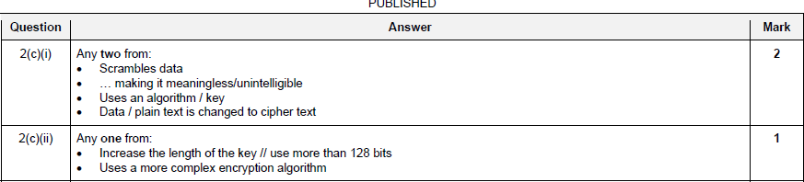
IGCSE Past Paper Exam – Answer 4
By: Noureddine Tadjerout

